Slide 1
Stack, Queue in C++ STL Md. Alamgir Hossain Senior Lecturer, Dept. of CSE, Prime University Mail: alamgir.cse14.just@gmail.com

Slide 2
Stack
Stacks are a type of container adaptors with LIFO(Last In First Out) type of working, where a new element is added at one end and (top) an element is removed from that end only.

Slide 3
Some Common Functions Associated with Stack
empty() – Returns whether the stack is empty – Time Complexity : O(1)
size() – Returns the size of the stack – Time Complexity : O(1)
top() – Returns a reference to the top most element of the stack – Time Complexity : O(1)
push(g) – Adds the element ‘g’ at the top of the stack – Time Complexity : O(1)
pop() – Deletes the top most element of the stack – Time Complexity : O(1)

Slide 4
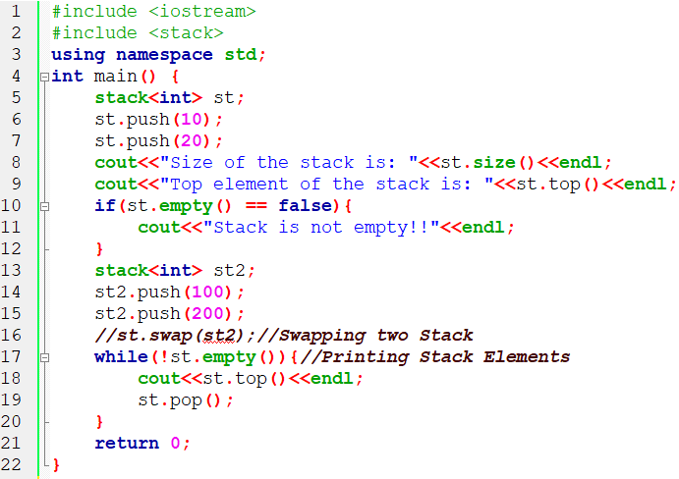
Using some Stack Functions in C++

Slide 5
Queue
Queues are a type of container adaptors that operate in a first in first out (FIFO) type of arrangement.
Elements are inserted at the back (end) and are deleted from the front.

Slide 6
Some Function of Queue in C++ STL
empty() – Returns whether the queue is empty.
size() – Returns the size of the queue.
queue::swap() in C++ STL: Exchange the contents of two queues but the queues must be of the same type, although sizes may differ.
queue::emplace() in C++ STL: Insert a new element into the queue container, the new element is added to the end of the queue.
queue::front() and queue::back() in C++ STL– front() function returns a reference to the first element of the queue.
back() function returns a reference to the last element of the queue.
push(g) and pop() – push() function adds the element ‘g’ at the end of the queue.
pop() function deletes the first element of the queue.

Slide 7
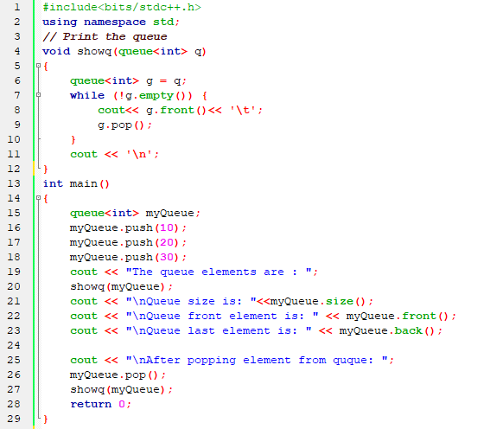
Some Function of Queue in STL C++

Slide 8
HomeWork
Write a C++ program to store 10, 20, 30, 50, 60 into a queue "q1" 100, 200, 300, 400, 500, 600 into another queue "q2" and performing the following operation:
i. add the first value of q1 and the last value of q2
ii. exchange the contents of q1 and q2
iii. remove the elements of the same position from q1 and q2

Slide 9
Thank You

